Slide 1
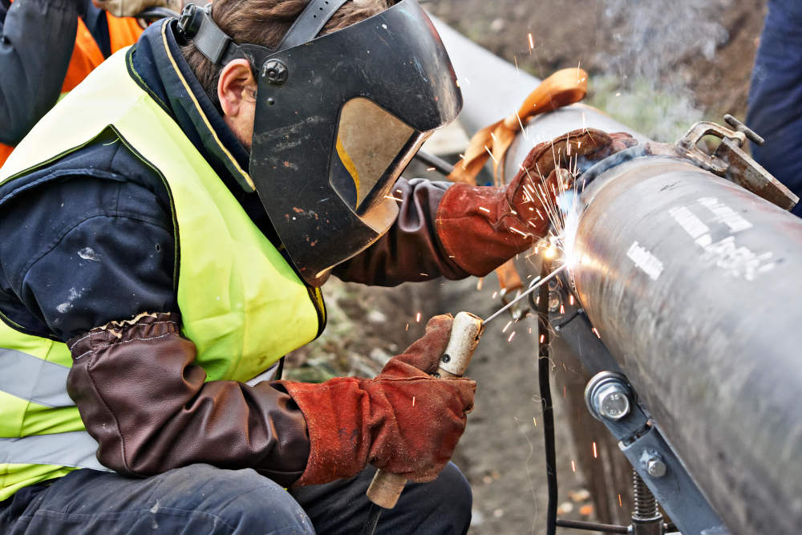
ARC WELDING

Slide 2
Def:
The welding in which the electric arc is produced to give heat for the purpose of joining two surfaces is called electric arc welding.
The joining is done by fusing two or more pieces of metal together by using the heat produced from an electric arc .
The welder creates an electric arc that melts the base metals and filler metal (consumable) together so that they all fuse into one solid piece of metal.

Slide 3
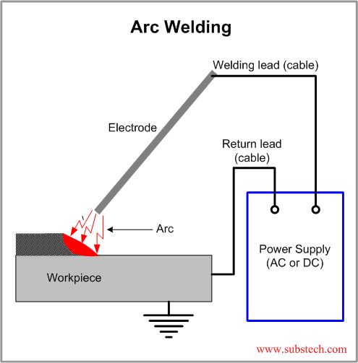
Fig. Basic circuit for arc welding

Slide 4
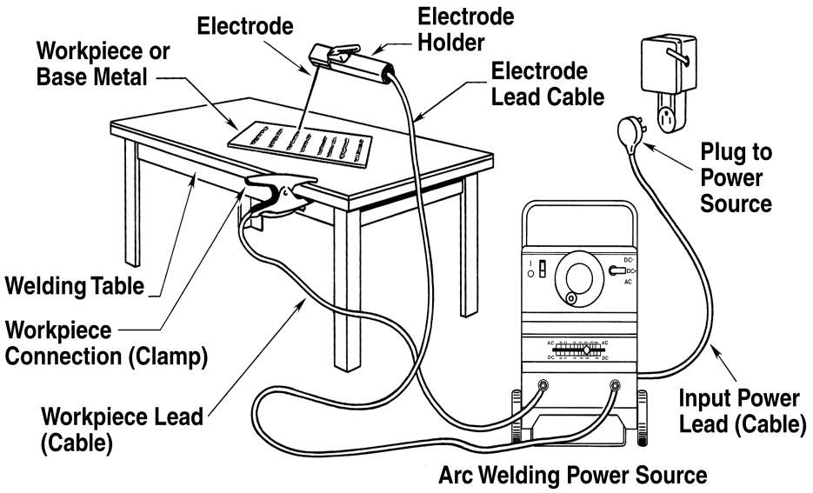
Arc Welding Setup

Slide 5
Principle of Arc :
An arc is generated between cathode and anode when they are touched to establish the flow of current and then separated by a small distance.
65% to 75% heat is generated at the anode.
An electric current, in the form of either alternating current or direct current from a welding power supply, is used to form an electric arc between the electrode and the metals to be joined.
If DC is used and the work is positive (the anode of the circuit), the condition is known as straight polarity (SPDC).

Slide 6
If work is negative and electrode is positive, it is reverse polarity (RPDC).
SPDC conditions are preferred.
DC arc‐welding maintain a stable arc and preferred for difficult tasks such as overhead welding.
For a stable arc, the gap should be maintained.
Manual arc welding is done with shielded (covered) electrodes.
Non consumable electrodes (e.g tungsten) is not consumed by the arc and a separate metal wire is used as filler.

Slide 7
Electrode
1. Non‐consumable Electrodes
2. Consumable Electrodes
Non‐consumable Electrodes
Made of carbon, Graphite or Tungsten.
Carbon and Graphite are used for D.C.
Electrode is not consumed, the arc length remains constant, arc is stable and easy to maintain.
Consumable Electrodes
Provides filler materials.
Same composition.
This requires that the electrode be moved toward or away from the work to maintain the arc and satisfactory welding conditions.

Slide 8
Gas shields
As the weld is laid, the flux coating of the electrode disintegrates, giving off vapors that serve as a shielding gas and providing a layer of slag, both of which protect the weld area from atmospheric contamination.
An inert gas is blown into the weld zone to drive away other atmospheric gases.
Gases are argon, helium, nitrogen, carbon dioxide and a mixture of the above gases.
Argon ionizes easily requiring smaller arc voltages. It is good for welding thin sheets.
Helium, most expensive, has a better thermal conductivity, is useful for thicker sheets, copper and aluminium welding, higher deposition rate.

Slide 9
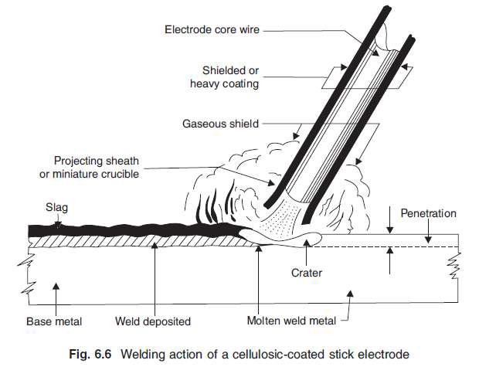

Slide 10
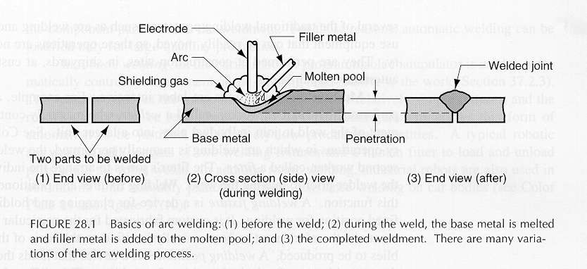

Slide 11
Advantages of Arc Welding:
Simple welding equipment.
Portable.
Inexpensive power source.
Relatively inexpensive equipment.
Welders use standard domestic current.
Electric arc is about 5,000ºC
Used for maintenance, repair, and field construction

Slide 12
Limitations :
Not clean enough for reactive metals such as aluminium and Titanium.
The deposition rate is limited because the electrode covering tends to overheat and fall off.
The electrode length is ~ 35 mm and requires electrode changing, which lowers the overall production rate.

Slide 13
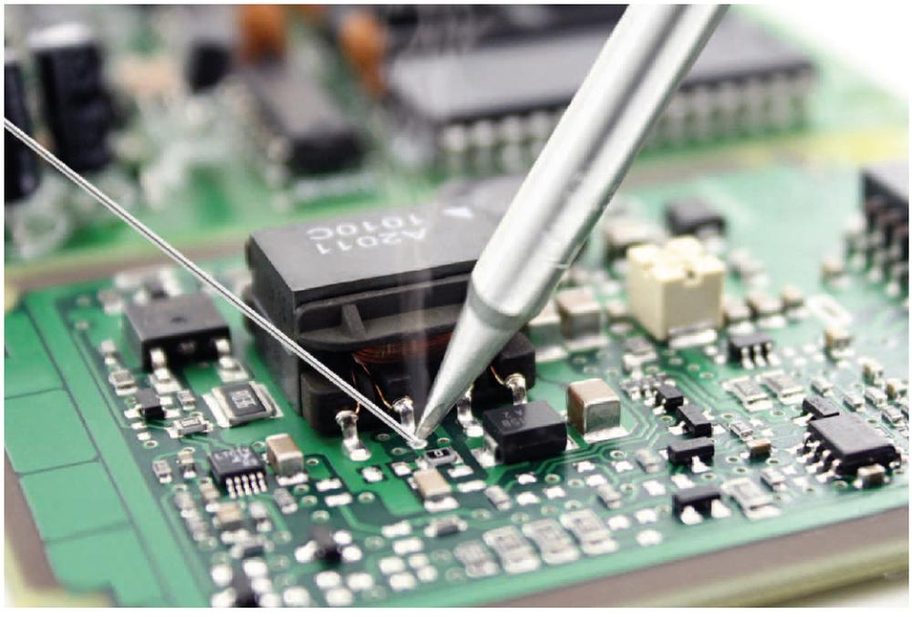
Other welding Methods

Slide 14
Brazing
Brazing is the joining of metals through the use of heat and a filler metal whose melting temperature is above 450°C; but below the melting point of the metals being joined.
Comparison between welding and brazing process
The composition of the brazing alloy is significantly different from that of the base metal.
The strength of the brazing alloy is substantially lower than that of the base metal.
The melting point of the brazing alloy is lower than that of the base metal, so the base metal is not melted.
Capillary action or capillary attraction draws the molten filler metal into the joint, even against the flow of gravity.

Slide 15
Brazing metals are typically alloys such as,
Brazing brass (60% Cu, 40%Zn)
Manganese bronze
Nickel silver
Copper silicon

Slide 16
Extremely clean surface needed for brazing.
Fluxes used are combinations of borax, boric acid, chlorides, fluorides, tetra‐borates and other wetting agents.
A popular composition is 75% borax and 25% boric acid.
Base materials will not melt.

Slide 17
Brazing process has several distinct advantages:
All metals can be joined.
Suited for dissimilar metals.
Quick and economical.
Less defects.

Slide 18
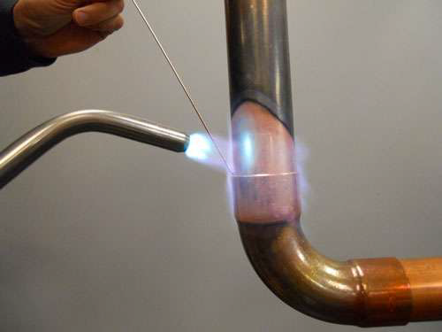
Joining of Capillary Tube

Slide 19
Braze Welding
Edge preparation needed.
Can join cast iron.
Done with an oxyacetylene torch.
Filler metal is an alloy of Cu and Tin (Bronze)
Enter into the workpiece by means of gravity force.
Strength of joint is more than Brazing.
Application :
Joining of cutting tool tips.

Slide 20
Soldering
By definition, soldering is a brazing type of operation where the filler metal has a melting temperature below 450°C.
Strength of the filler metal is low.
Soldering is used for a neat leak‐proof joint or a low resistance electrical joint.
Not suitable for high‐temp. application.
Most solders are alloys of lead and tin.

Slide 21
Solder Flux
Ammonium chloride or rosin for soldering tin.
Hydrochloric acid and zinc chloride for soldering galvanized iron.
Some fluxes are corrosive and should be removed after use.
Silver solders uses for higher‐temperature service, Electrical and Electronic purpose.

Slide 22
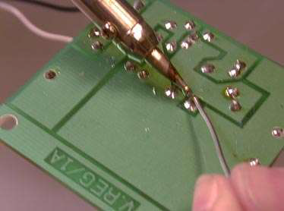
Soldering

Slide 23
Welding Defects :
Defect |  | Reason
1. | Cracking of weld metal | High joint rigidity
2. | Cracking of base metal | Excessive stress
3. | Spatter | Arc blow
4. | Distortion | Poor joint selection
5. | Slag Inclusion | Improper cleaning in multipass welding
6. | Porosity | Excessive H2, O2, N2, in the welding atmosphere or Damp electrodes

Slide 24
Basic Welded Joints
Lap Joint
Butt Joint
Edge Joint
Corner Joint
T-Joint

Slide 25
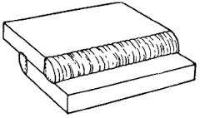
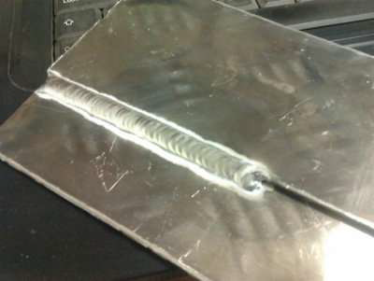
Lap Joint
Lap Joint- a joint between two overlapping members.

Slide 26
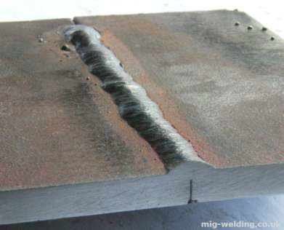
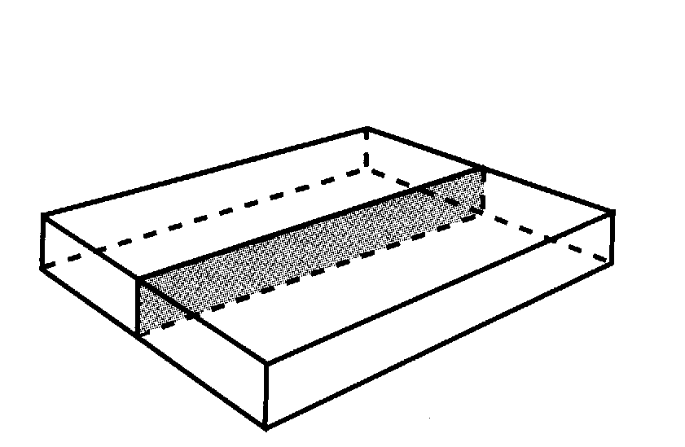
Butt Joint
Butt joint- a joint between two members aligned approximately in the same plane.

Slide 27
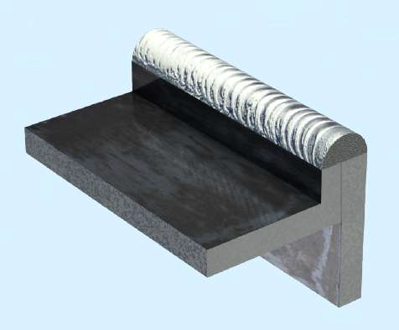
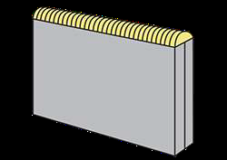
Edge Joint
Edge joint- a joint between the edges of two or more parallel or nearly parallel members.

Slide 28
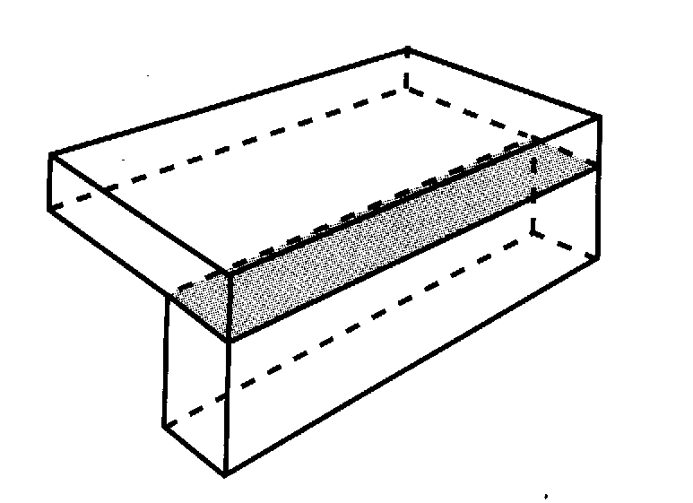
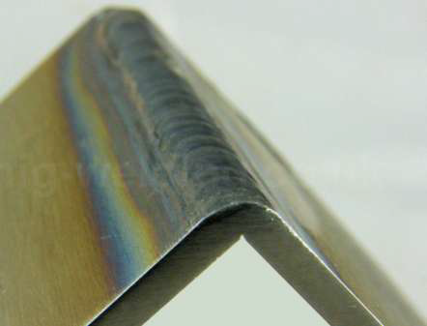
Corner Joint
Corner joint - a joint between two members located at right angles to each other.

Slide 29
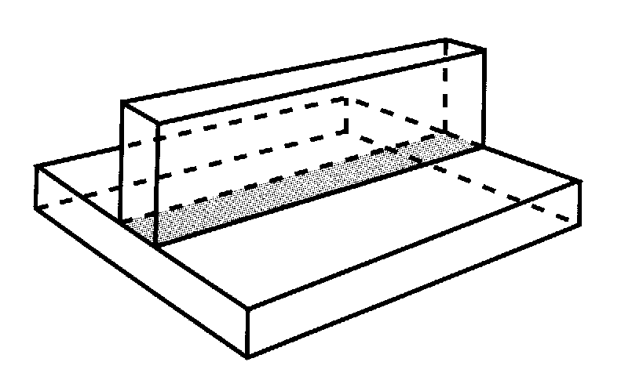
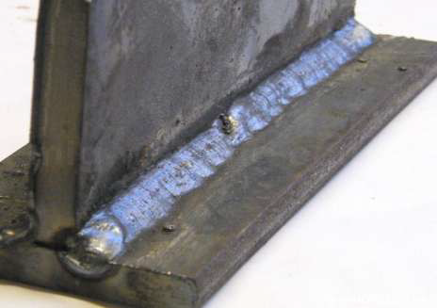
T-Joint
T- joint - a joint between two members located approximately at right angles to each other in the form of T.

